Slide 1
Trash-free Mystic
MyRWA’s goals and planS
Andy Hrycyna
Mystic River Watershed Steering Committee
September 10, 2020

Slide 2
Most trash in the ocean comes from rivers
Most trash in rivers comes off the land

Slide 3
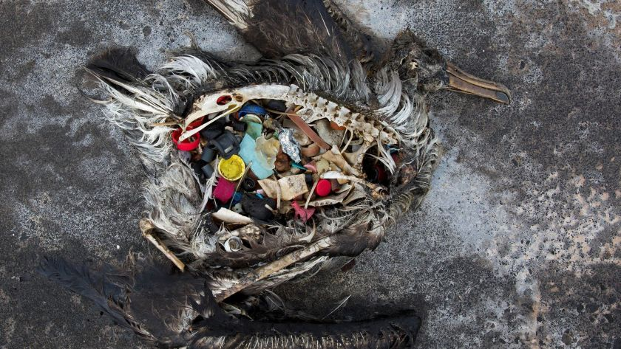
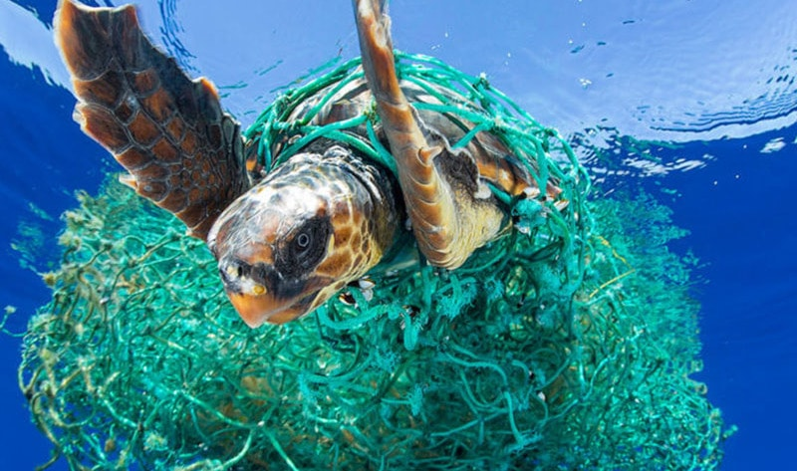
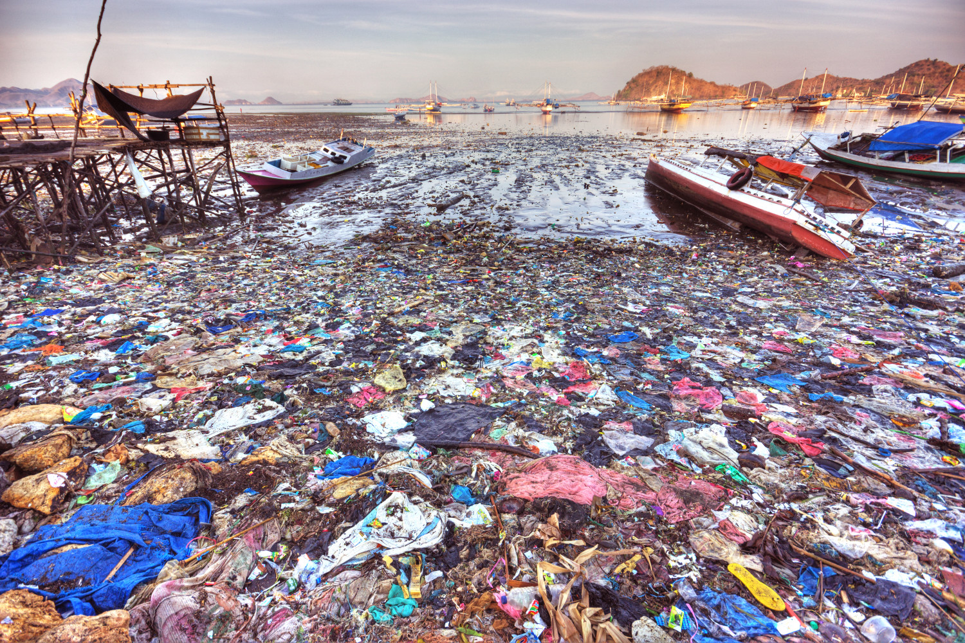
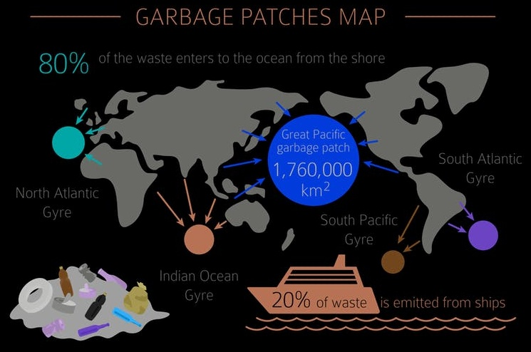
Plastic in the oceans

Slide 4
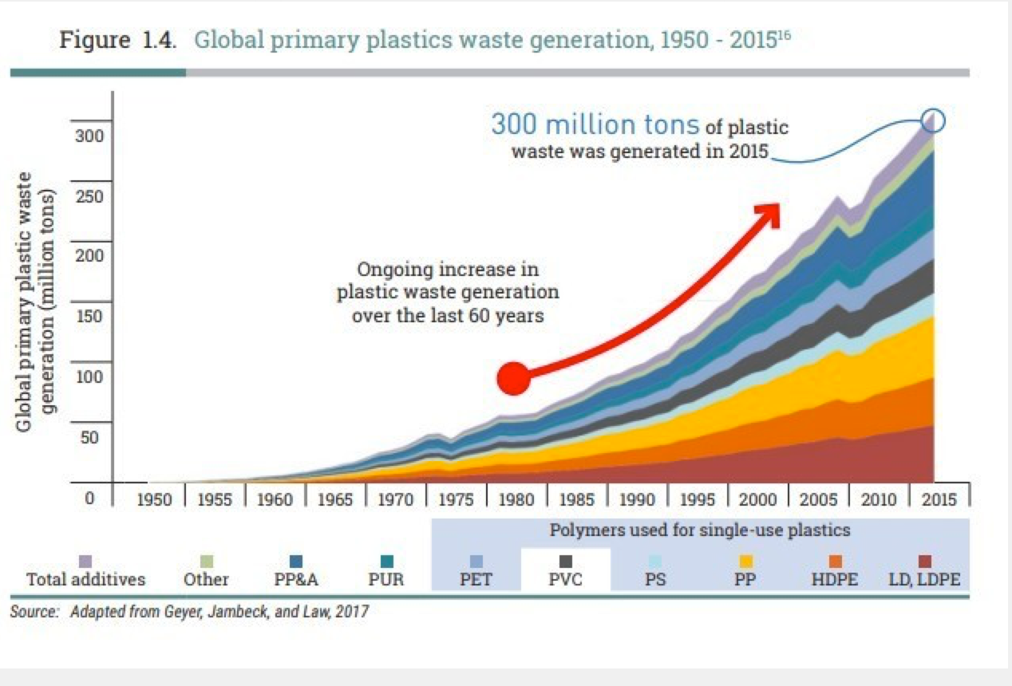
Plastic waste generation, 1950-2015

Slide 5
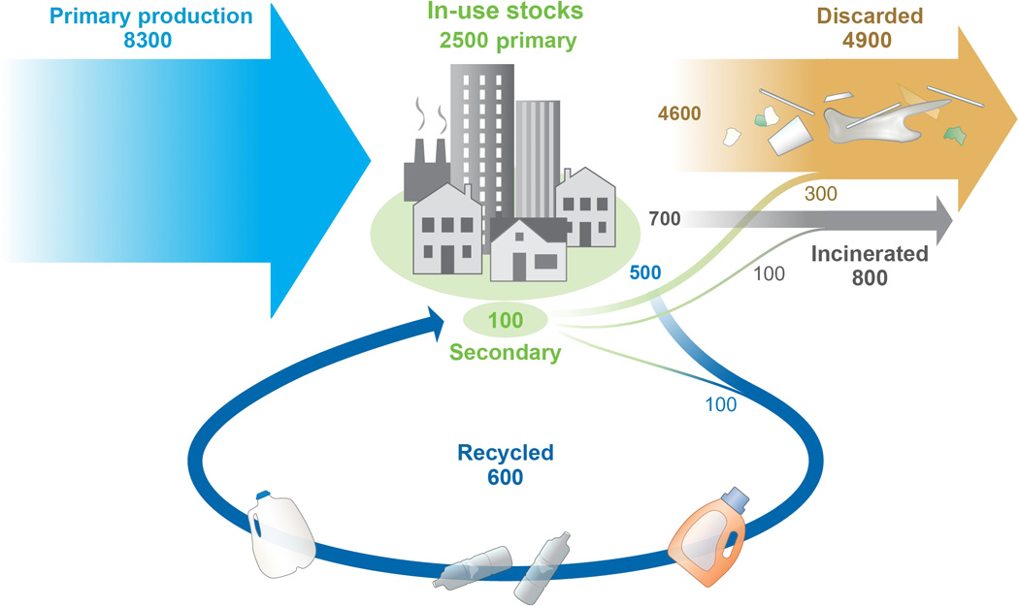
Production and fate of all plastic ever made
Production, use, and fate of all plastics ever made. Geyer, et al, Science Advances (2017)

Slide 6
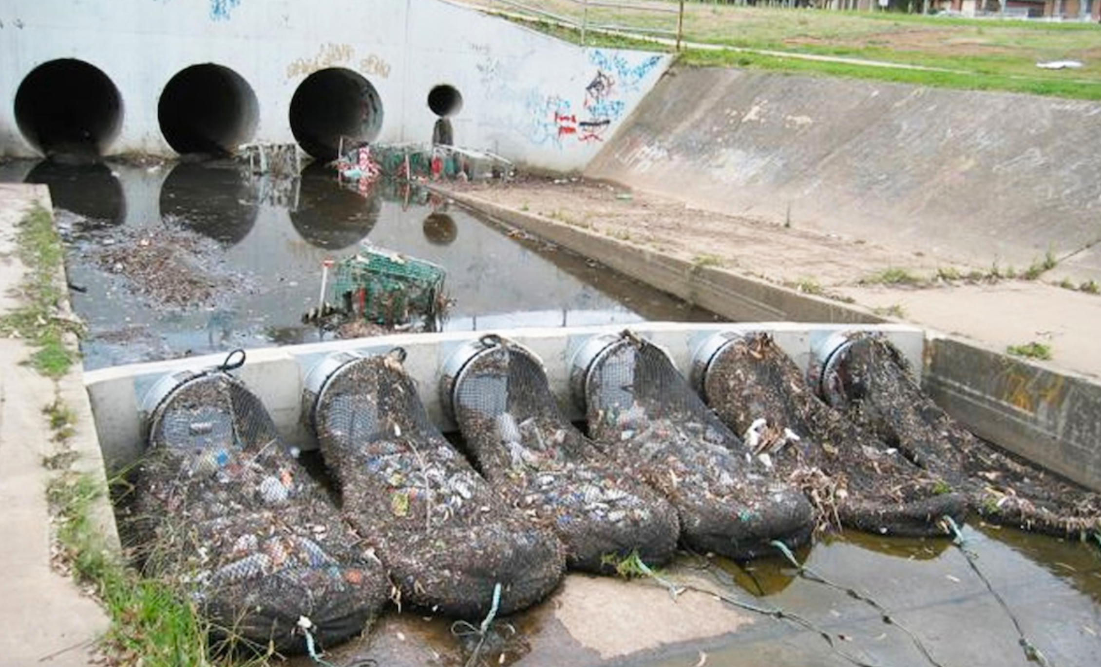
Message: Stormwater pipes carry trash to rivers

Slide 7
What are our goals?
5 years: reduce trash inputs in the Mystic River –and parks?—using some feasible metric
Identify the biggest levers for change-- the policies and best management practices with the biggest bang for the buck
Advocate for those changes
Improve the aesthetics of rivers and parks
Use trash as tool of engagement and education

Slide 8
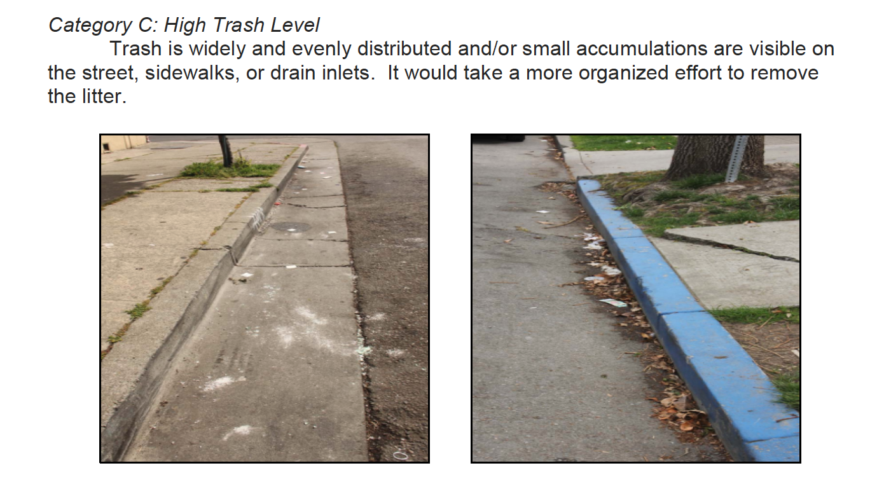
EPA Visual Trash Assessment Protocol

Slide 9
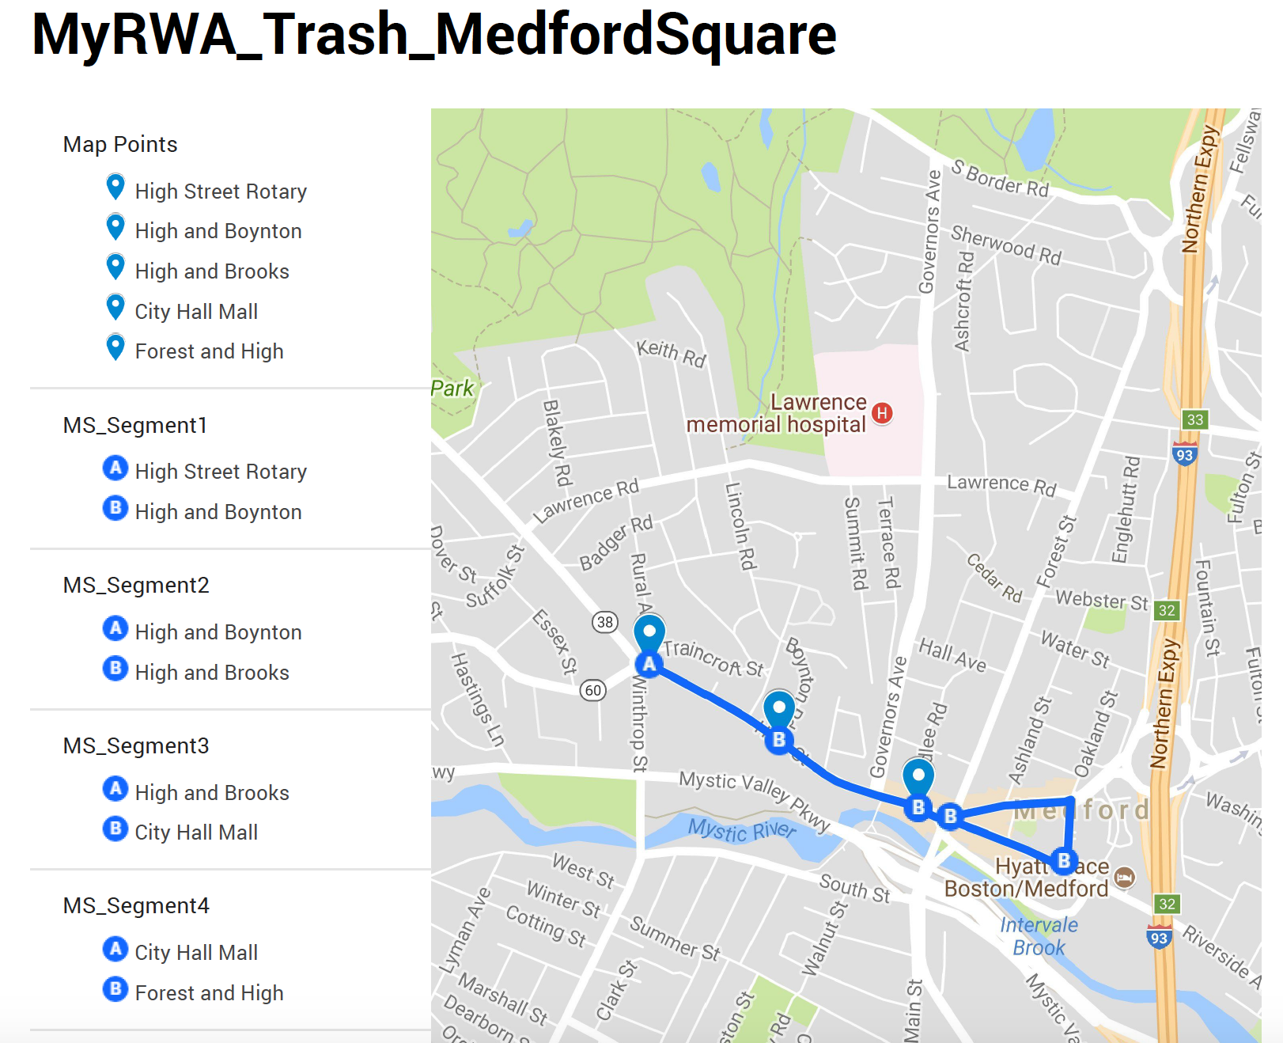

Slide 10
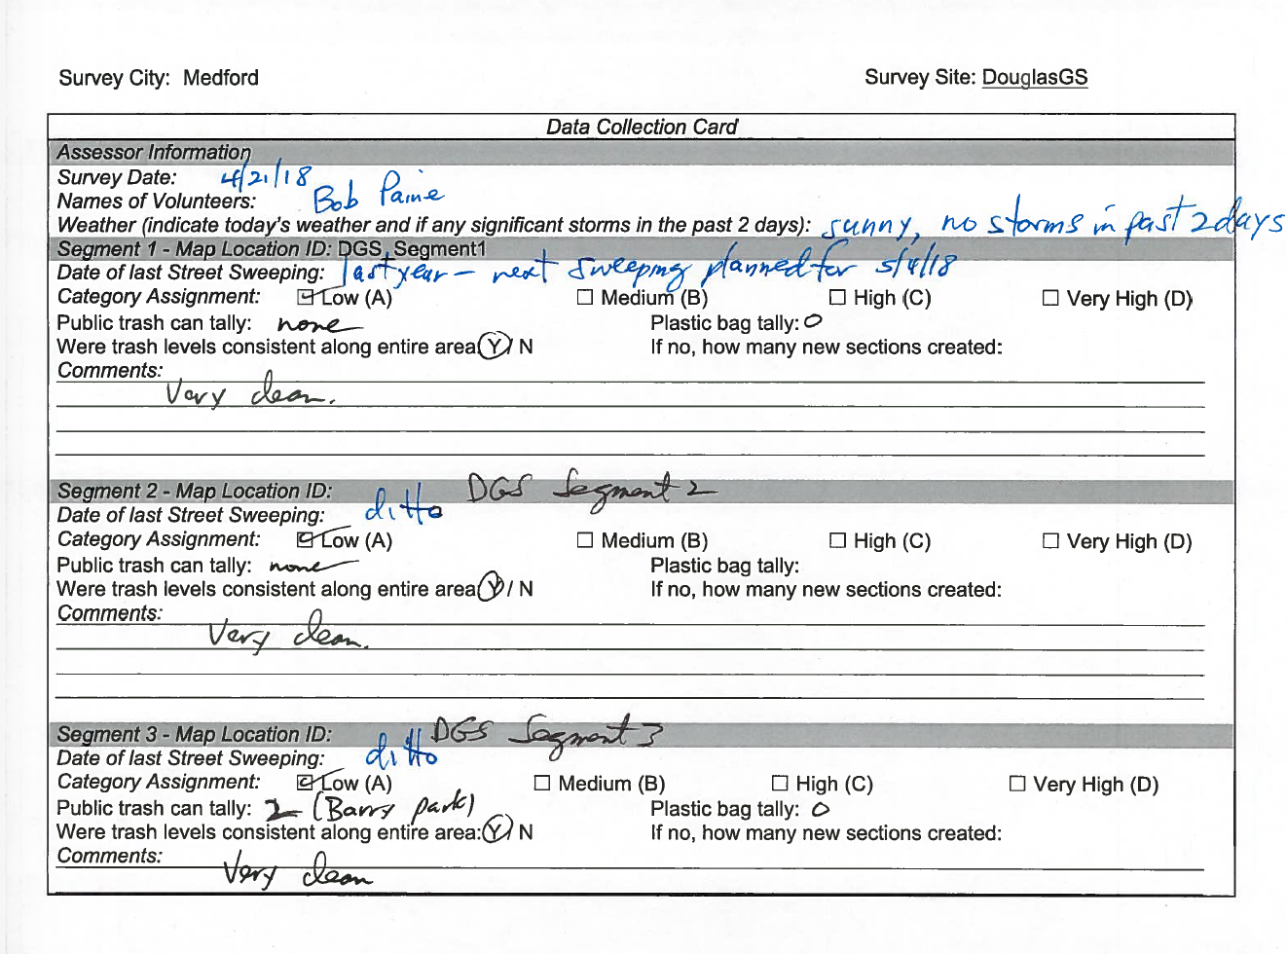

Slide 11
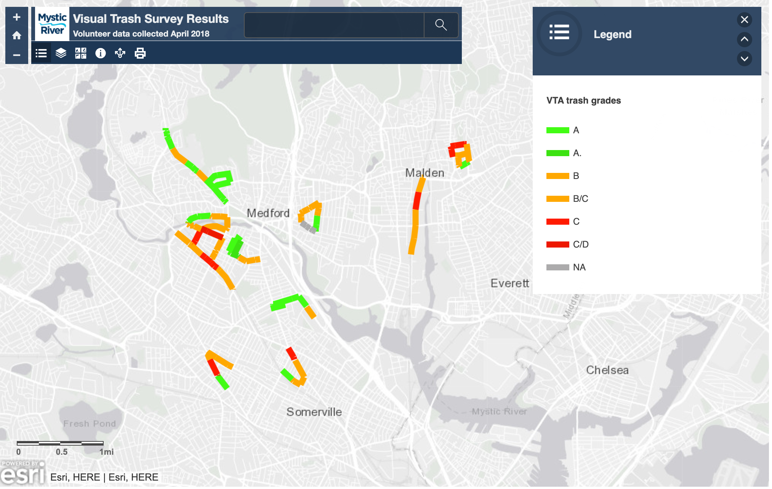

Slide 12
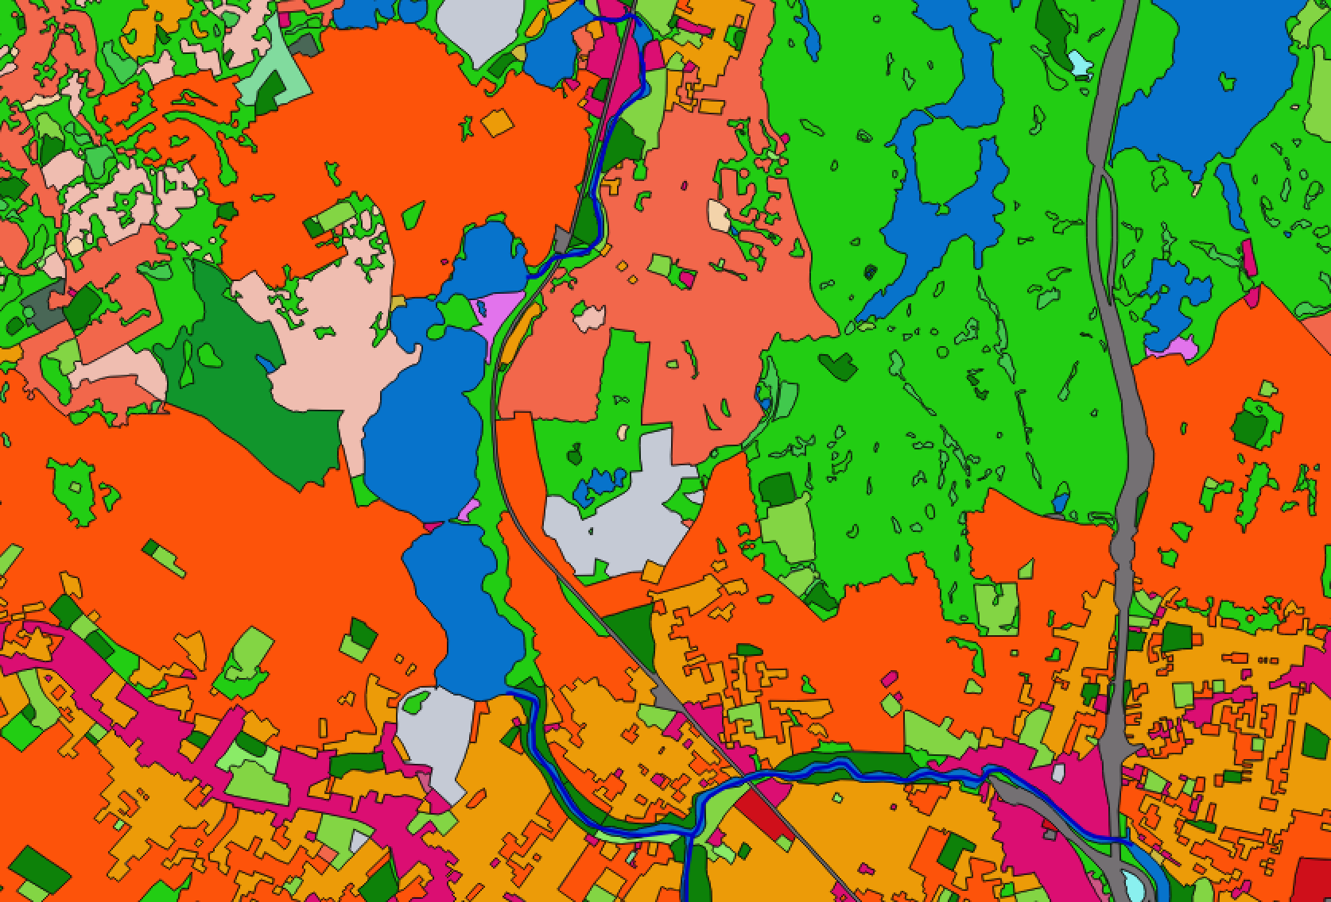
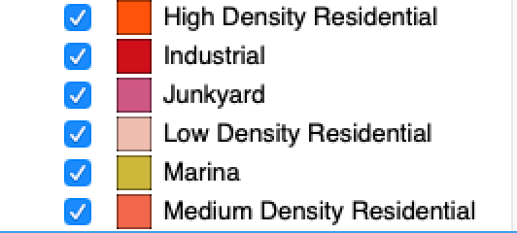

Slide 13
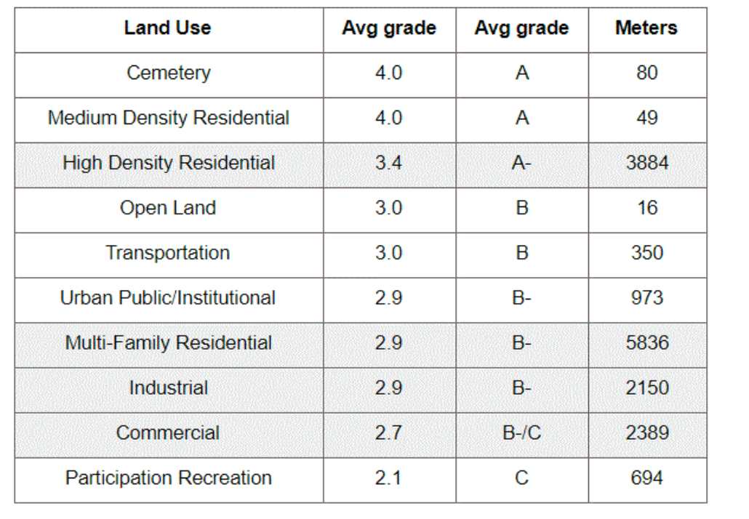
Results

Slide 14
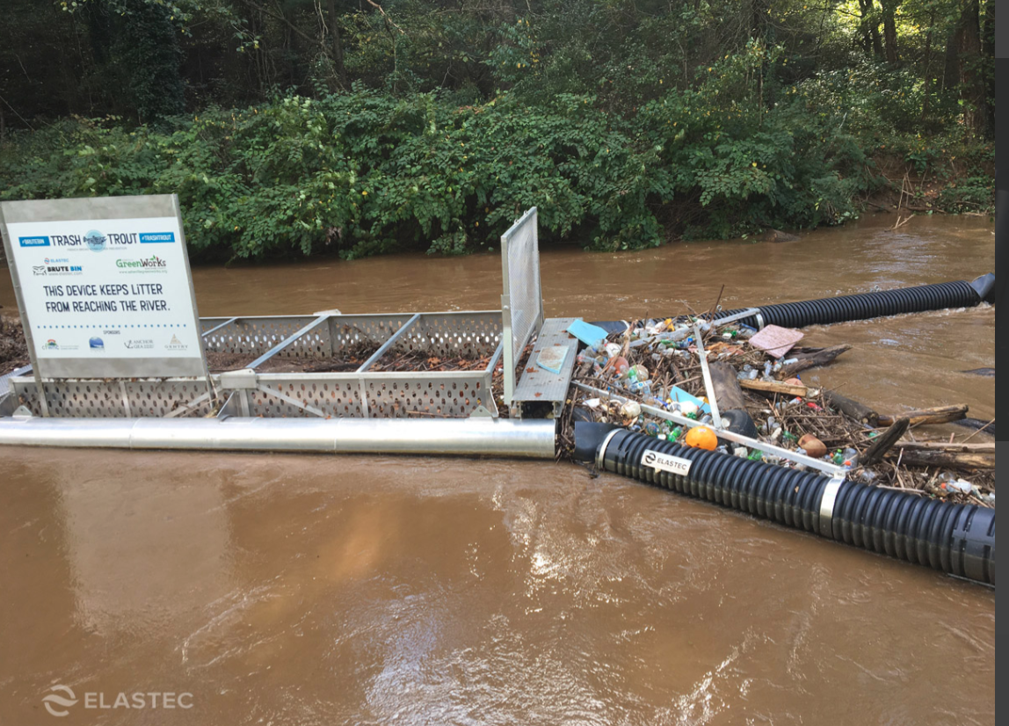
NAWCA Grant: Malden River

Slide 15
EPA + CBI Interviews with Municipalities
Additional likely grants for equipment and monitoring
Collaborations with municipalities on messaging and best practices

