Slide 1
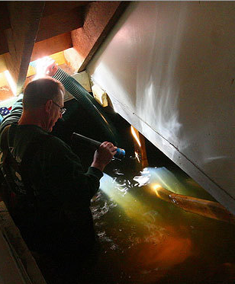
Resilient Mystic Collaborative
Mystic Science Forum
April 30, 2019

Slide 2
Why Climate Resilience at the Watershed Scale
Physical: mitigation is all about energy; much of adaptation is about water
Shared Impacts/Shared Solutions: actions have impact across municipal lines and can be paid for collectively
Political/Policy: leverage from collective action

Slide 3
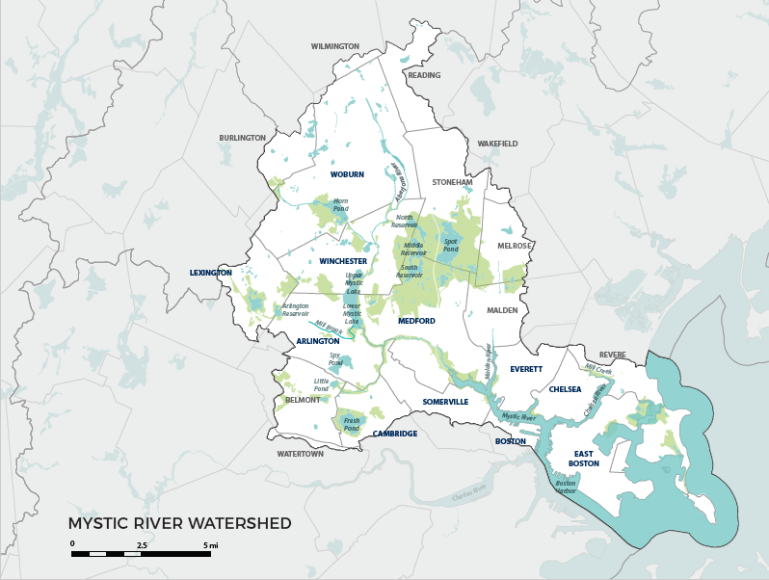

Slide 4
2/3 of Municipalities in Resilient Mystic Collaborative
Arlington
Boston
Cambridge
Chelsea
Everett
Lexington
Malden
Medford
Somerville
Stoneham
Wakefield
Winchester
Winthrop
Woburn

Slide 5
Additional Watershed Municipalities
Belmont
Burlington
Melrose
Reading
Revere
Watertown
Wilmington

Slide 6
Vision
We are data-driven and action-oriented.
We share a pragmatic, optimistic vision that recognizes the Mystic River as a tremendous asset.
We are mutually supportive.
We have the governance, trust, and participation to maximize our effectiveness.

Slide 7
Five Working Groups
Upper Mystic
Social Resilience
Lower Mystic
Policy & Advocacy
Collaborative Governance

Slide 8
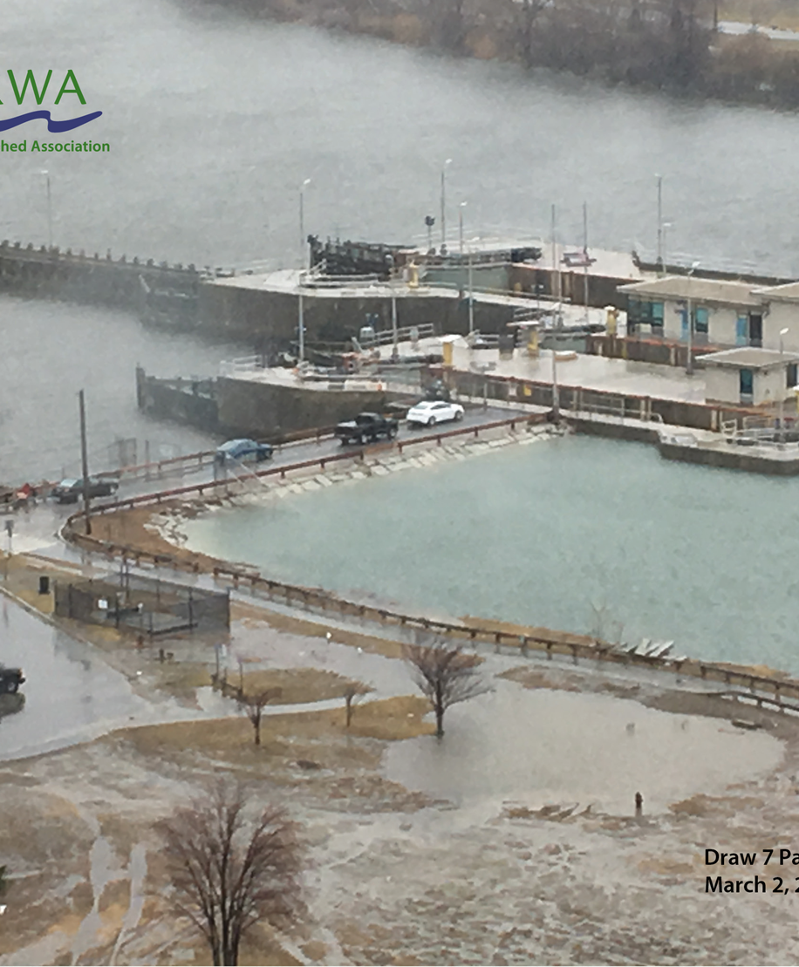
Lower Mystic

Slide 9
Key Areas of Focus
Lower Mystic has highest concentration of critical regional infrastructure in New England
Food
Energy
Transportation
Water treatment
Working with DHS on a regional preparedness plan prioritizing impact on vulnerable residents

Slide 10
Social Resilience

Slide 11
Key Areas of Focus
We are home to 9 of 15 most intensively environmentally burdened communities in MA
Partnering with service providers, community leaders to understand how to increase the resilience of our most vulnerable residents to extreme weather.

Slide 12
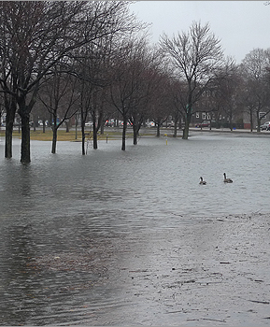
Upper Mystic

Slide 13
Key Areas of Focus
Watershed-wide flood scenario modeling
What can we do through regional stormwater retention projects?
What else do we have to do (active reservoir management, local projects)?
How much flooding can we manage?

