Slide 1
Town of Winchester
Mystic River Watershed Initiative Science Forum
April 30, 2019
Beth Rudolph, PE – Town Engineer

Slide 2
Winchester at a Glance
Population – 22,284 (2010)
Land area – 6.3 square miles, mostly built out
Land Use:
  65% residential
  20% open space/water
  10% municipal buildings & roads
  5% commercial & light industrial
Originally named “Waterfield”

Slide 3
Water Resources Challenges
Flooding along the Aberjona River and Horn Pond Brook
  273 structures in 100-year floodplain
  Over $25 million in flood-related loses since mid-1990’s
Water quality concerns
  303(d) list impairments –Ammonia, Arsenic, E. coli, DO, TP, and Turbidity
  Meets WQ standards for swimming & boating approx. 59.4% of the time
  Closures to beaches at Wedge Pond and Upper Mystic Lake
Summer low-flow conditions
Sedimentation of waterways
Financial constraints related to operating and capital budgets

Slide 4
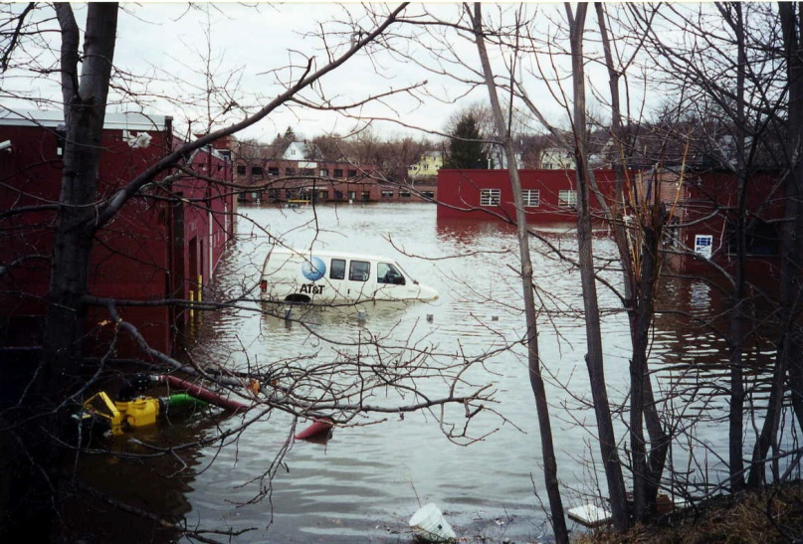
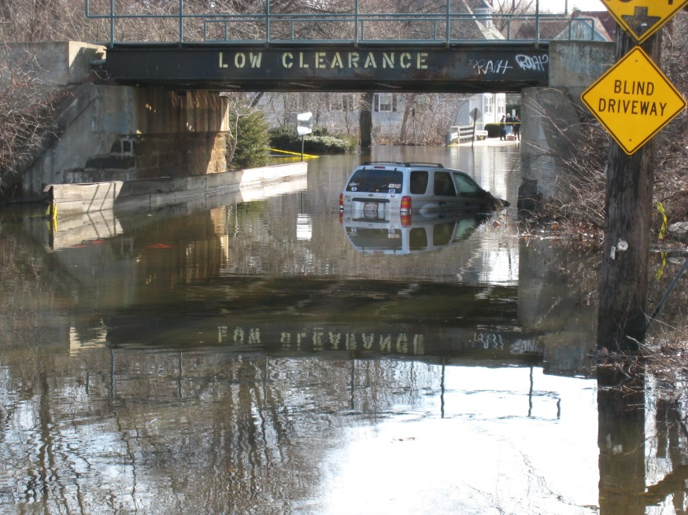

Slide 5
Projects and Initiatives
Flood Mitigation Program
  10 projects along the Aberjona River, upstream mitigation at Scalley Dam in Woburn, downstream mitigation at Mid-Lakes Dam.
  Began in 1996 and all but two projects completed.
Local Regulations
  Require projects to match pre and post-development runoff rates and volumes.
Stormwater Management projects
  Large scale infiltration/detention systems to mitigate neighborhood flooding
  319 Grant with MyRWA for “green infrastructure”
  Mystic Stormwater Management Collaborative – Arlington & Winchester
  NRD grant funding for the upper Mystic watershed
Fish ladder at Center Falls Dam completed in 2017
Stormwater Utility analysis

Slide 6
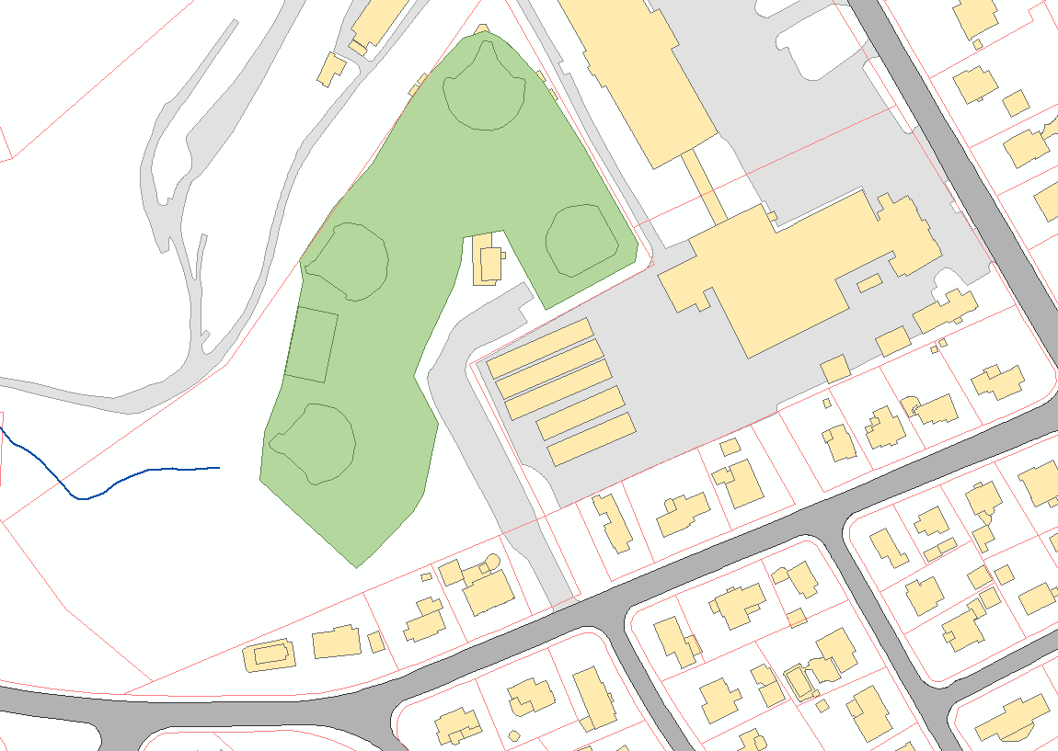
West Side Field Drainage Project + 319 Grant for Green Infrastructure
Large scale infiltration/detention system to mitigate downstream flooding
175,000 cubic feet of storage
$3.7 million cost
Coordination with 319 grant to install tree trenches in downstream area
West Side
Field
Infiltration/Detention System
Green Infrastructure

Slide 7
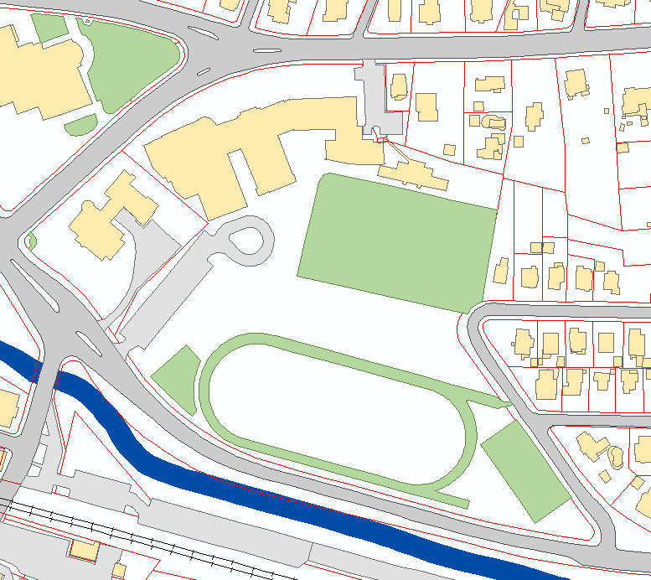
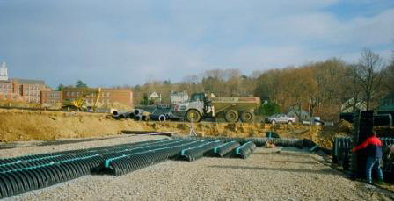
Manchester Field Drainage Project (2011)
Added 1-million cubic feet of underground storage

Slide 8
Future Goals and Initiatives
Maintain and improve the Town’s waterways as cultural and recreational resources, and improve aquatic habitat.
Preserve the Town’s investments in flood mitigation.
  Green infrastructure and stormwater retrofit projects.
Climate resiliency and preparation for increased precipitation amounts and extremes.
  FY20 MVP Planning Grant
Coordination with the Town’s Master Plan (on-going).

