Slide 1
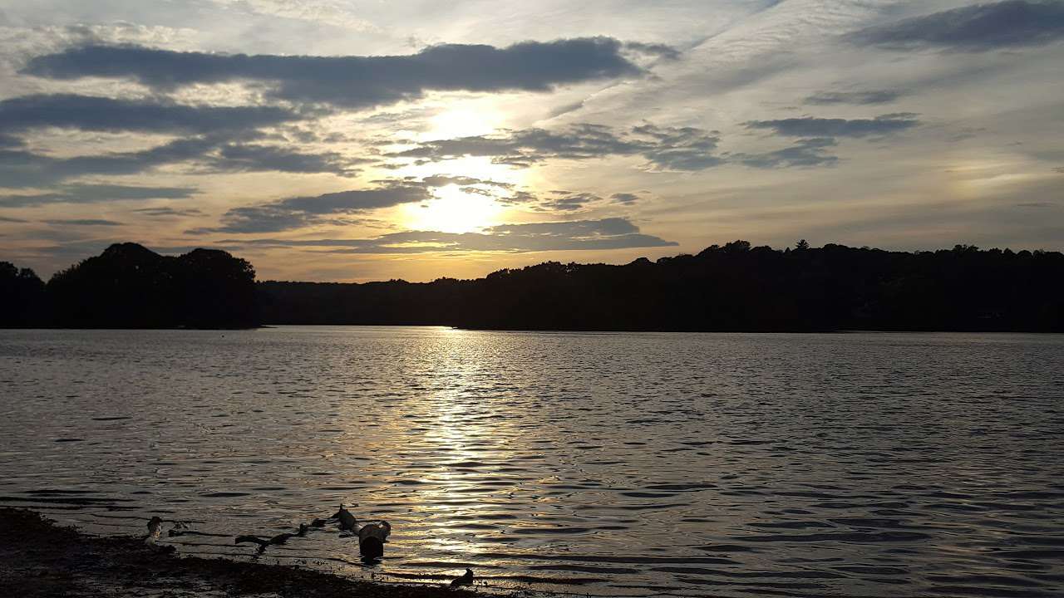
MassDEP Sampling in Mystic Lakes
Photo: Spy Pond Park, Brandon Bushey

Slide 2
Mystic Lakes Impairments
Mystic Lakes Impairments
Name | ID | Location | Size (Acres) | Draft 2016 IR Category 5
Horn Pond | MA71019 | Woburn | 108 | (Non-Native Aquatic Plants**) DDT in Fish Tissue, Harmful Algal Bloom, Oxygen, Dissolved Phosphorus (Total)
Spy Pond | MA71040 | Arlington | 98 | (Eurasian Water Milfoil, Myriophyllum spicatum**) Chlordane in Fish Tissue, DDT in Fish Tissue, Harmful Algal Bloom, Oxygen, Dissolved Phosphorus (Total)
Wedge Pond | MA71045 | Winchester | 23 | Harmful Algal Bloom Oxygen, Dissolved Phosphorus (Total)

Slide 3
EPA Alternative TMDL work
EPA Alternative TMDL work
Watersheds and Loadings for the three ponds have been calculated
This work can be used in a Lake Loading Response Model
Updated, recent water quality sampling data is needed

Slide 4
Mystic Lakes 2019 Sampling
3 ponds (Horn Pond, Wedge Pond and Spy Pond)
Index site sampling at deep hole
4 visits (June to October)
Surface and Bottom Nutrients (TN,TP)
Depth Integrated Chlorophyll a
Dissolved Oxygen Profile
Bathymetric Mapping Once Each Pond

Slide 5
Ponds/Lake Analysis Team
Ponds/Lake Analysis Team includes: Al Basile (EPA), Barbara Kickham (MassDEP), Matthew Reardon (MassDEP), Toby Stover (EPA), and Mark Voorhees (EPA)
Contact Information
Matthew Reardon (508-849-4002)
Matthew.Reardon@mass.gov

