Slide 1
Medford’s COVID City Cleanups
Presentation by Ellie Hunt and Zayn Yousuf

Slide 3
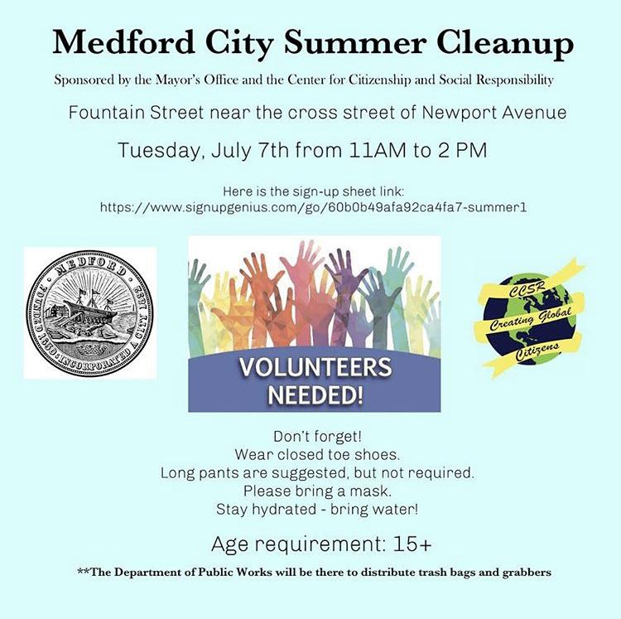
Event Flyer and Outreach
Notes:
Flyer outreach

Slide 4
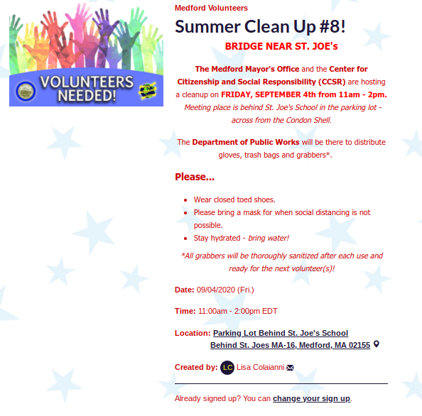
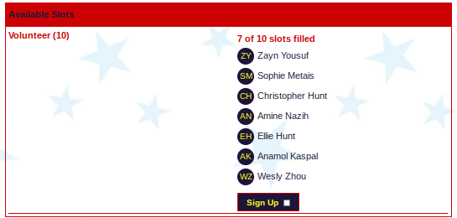
Signup Genius
Notes:
Sign up genius

Slide 5
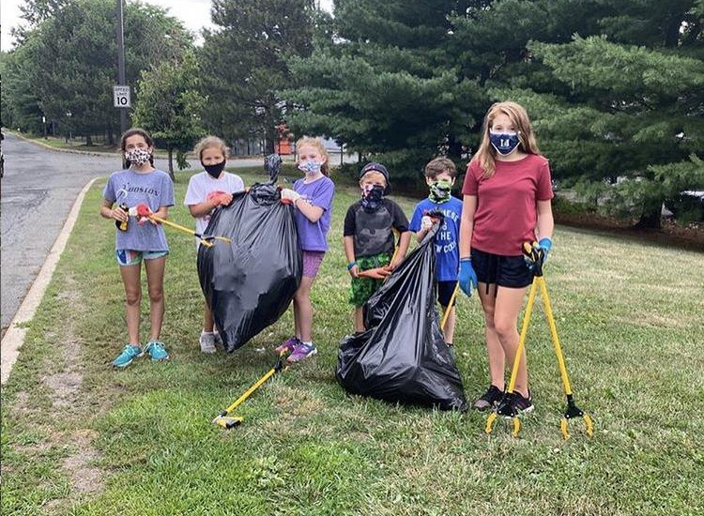
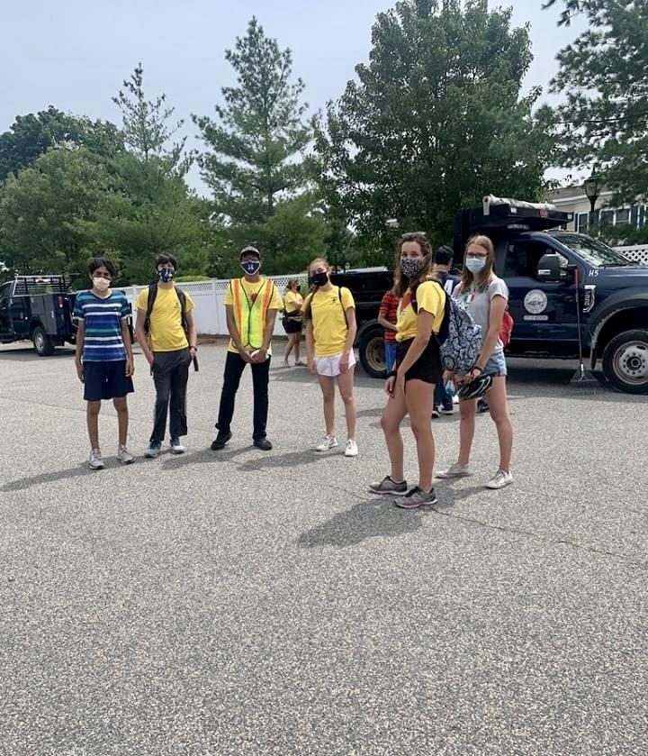
Notes:
separate tools and gloves provided by DPW For each person (cleaned after each cleanup)

Slide 6
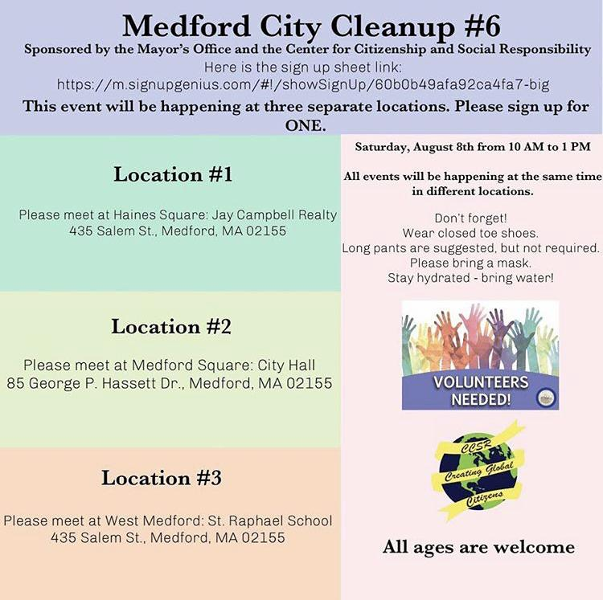
Multiple Location Event

Slide 7
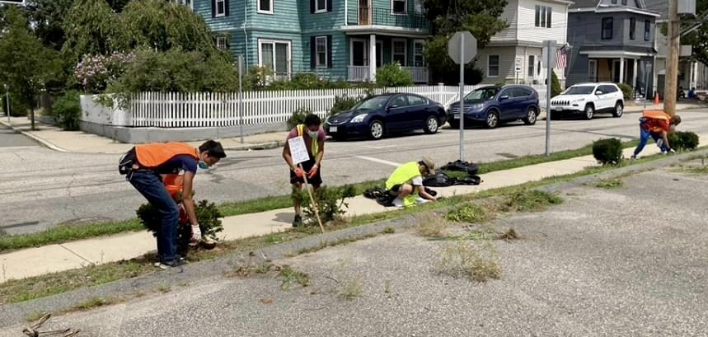
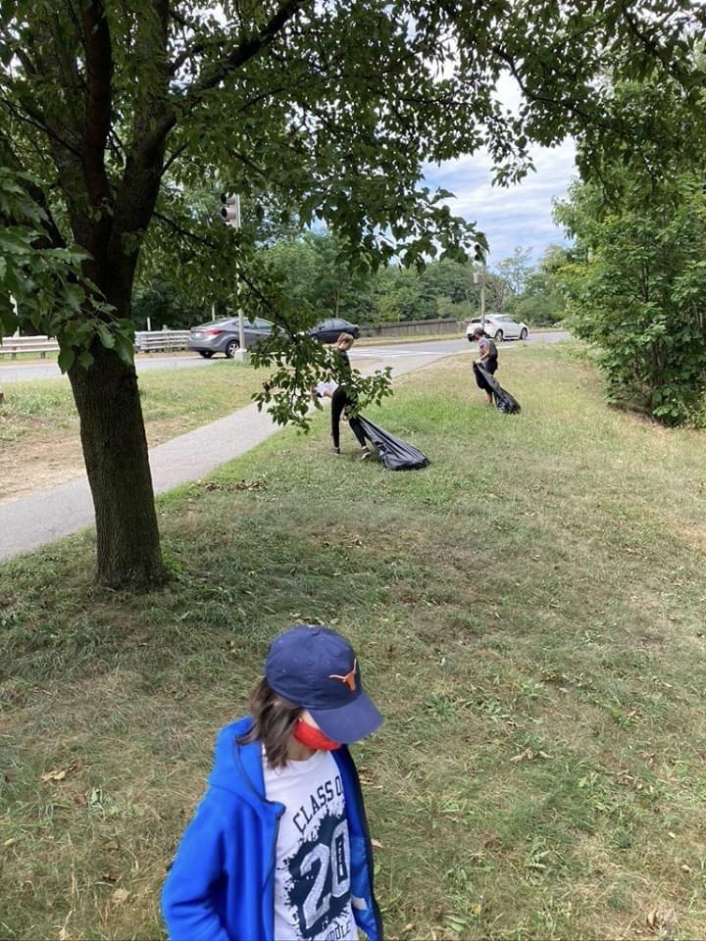
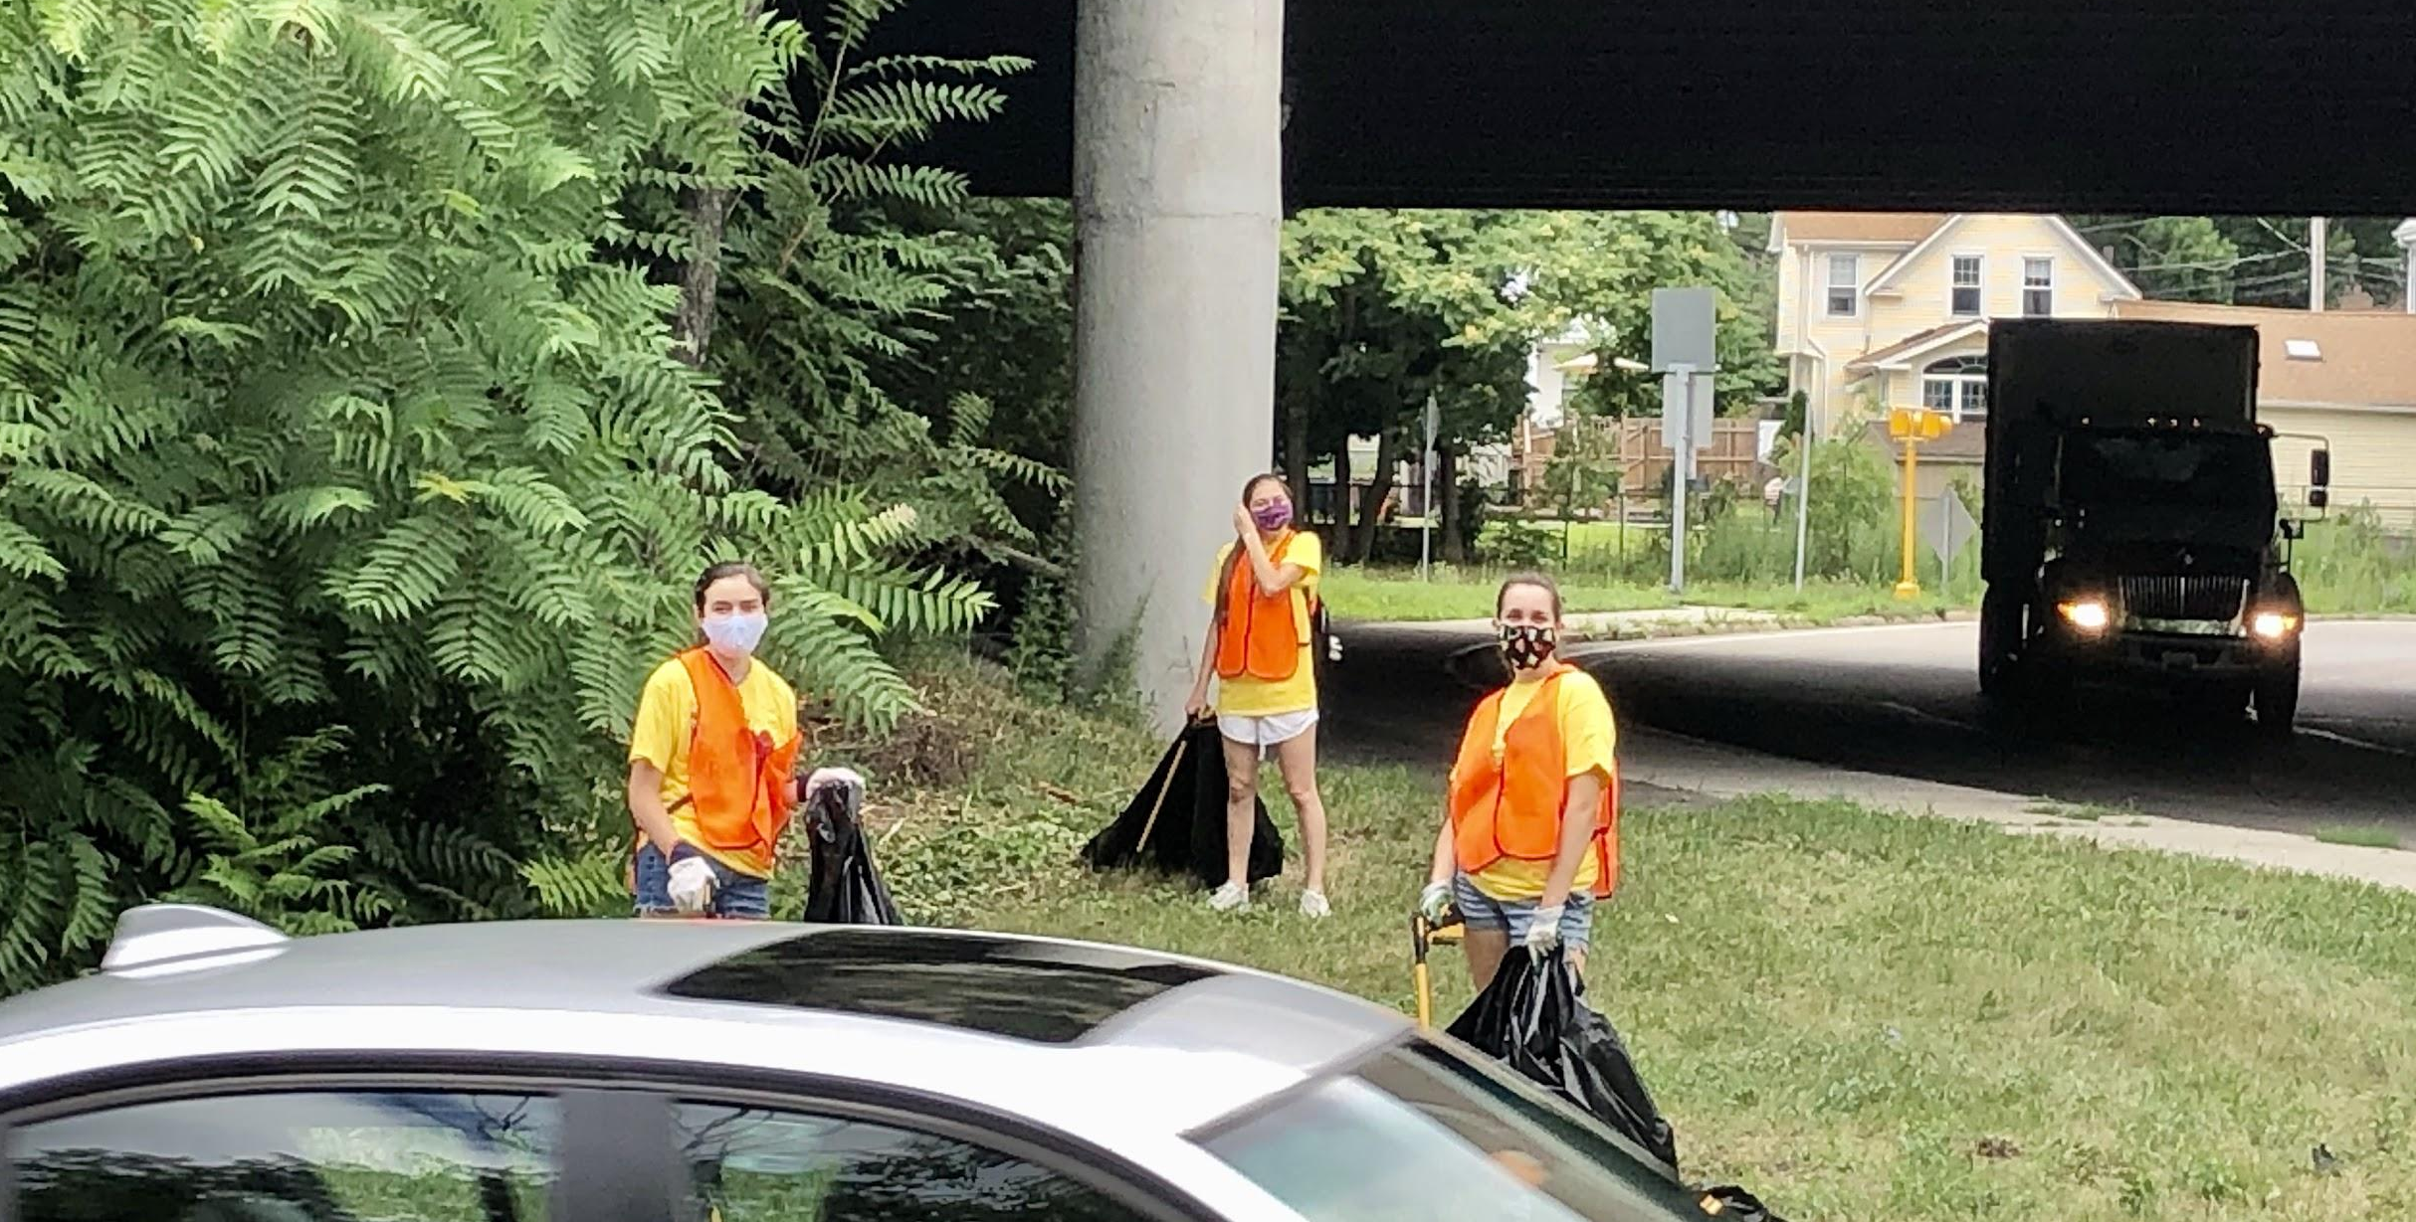
Notes:
Separate locations in small groups

Slide 8
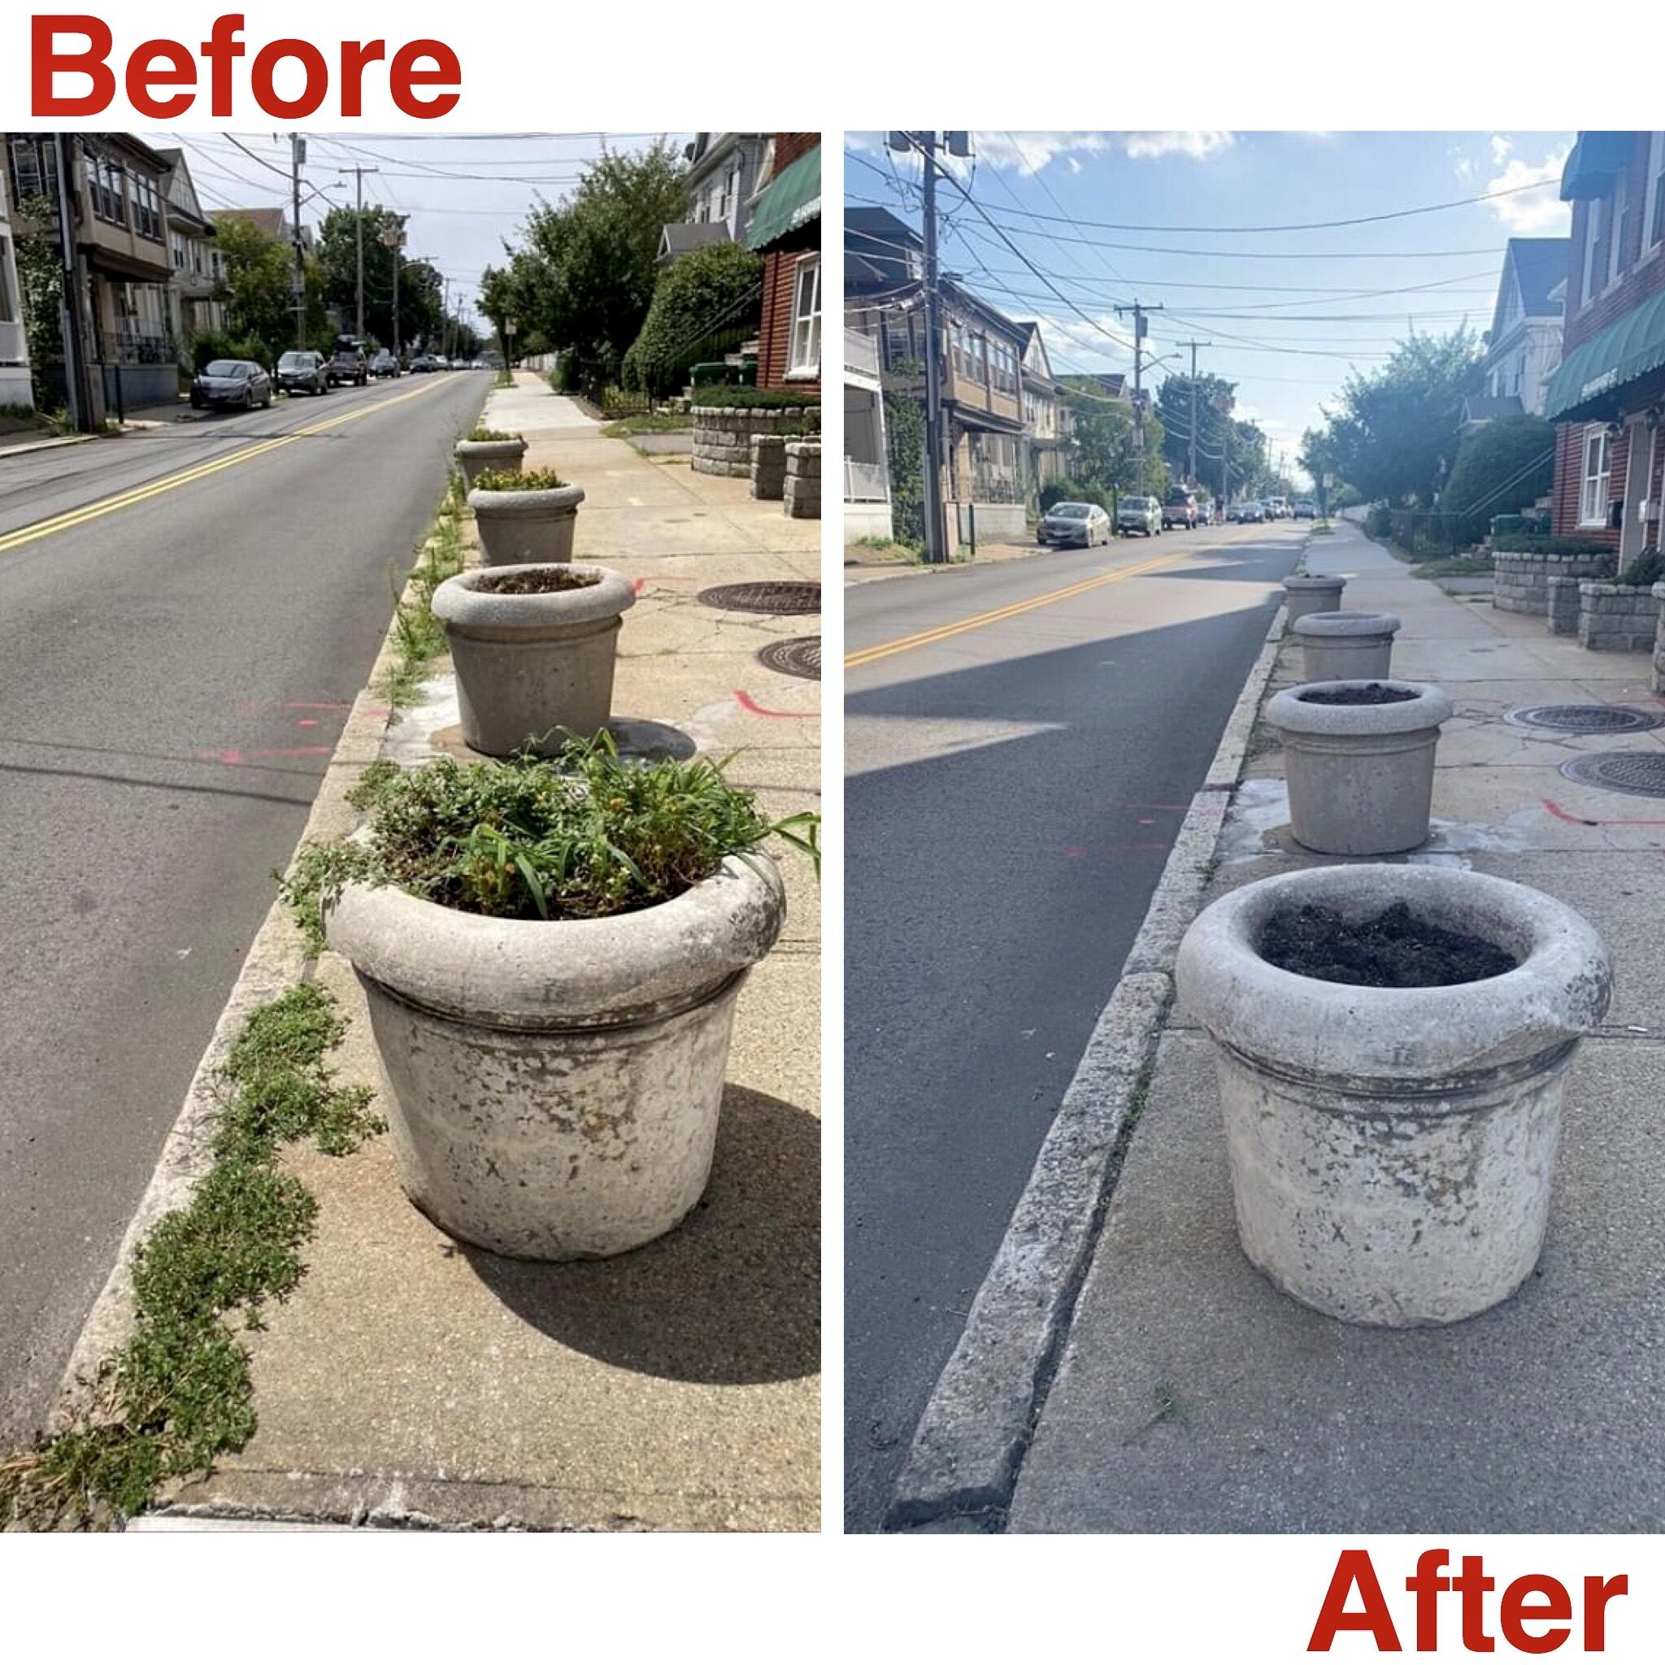
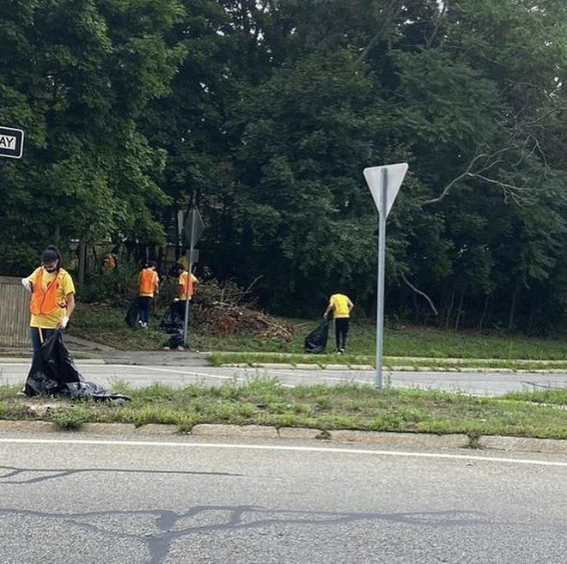
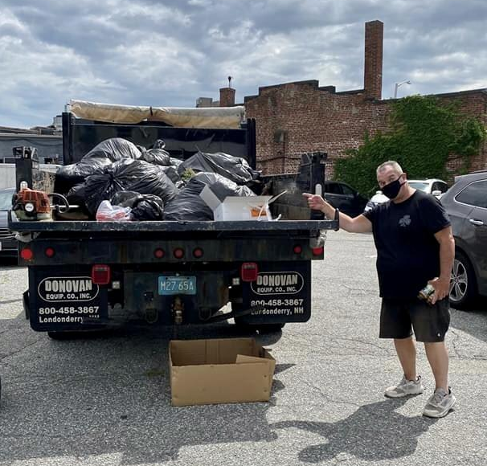
Notes:
Drawbacks

Slide 9
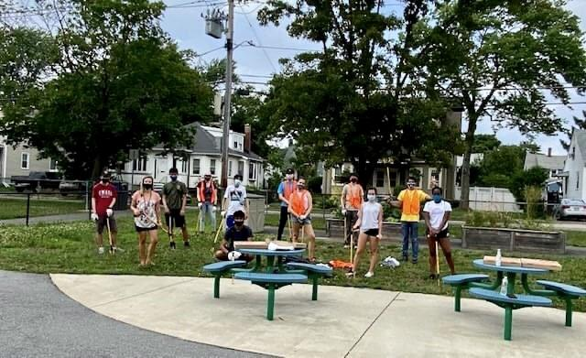
Notes:
Drawbacks: Small groups only - less work overall Not broad audience Selective participation Technology access required

Slide 10
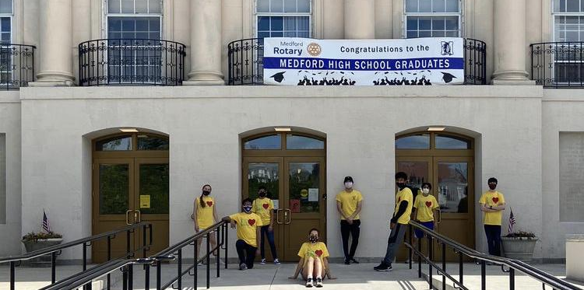
Notes:
Going forward

