Slide 1
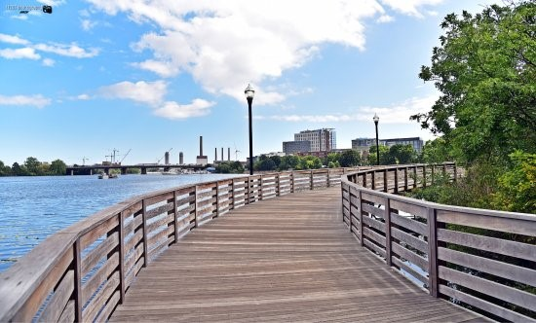
Mystic River/Alewife Brook
Floatables Control
Mystic River Steering Committee
September 10, 2020

Slide 2
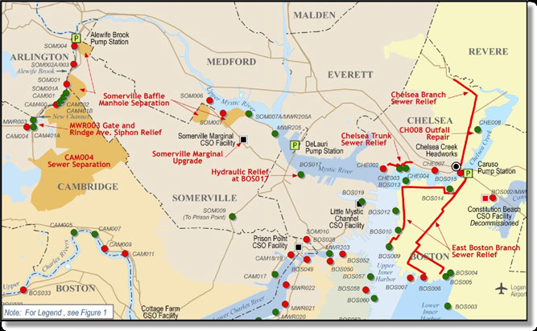
MWRA CSO Control Program

Slide 3
Managing Floatables
Source Controls
In-System Controls
End of Pipe Controls

Slide 4
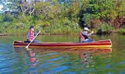
Source Controls-Reduction of CSO Discharges
System-Wide volume reductions of nearly 2.9 billion gallons of CSO discharge per year
35 of 84 outfalls closed
13 of remaining outfalls do not discharge in the typical year
25 year level of control along the South Boston beaches
91% of remaining flow is treated at 4 CSO treatment facilities

Slide 5
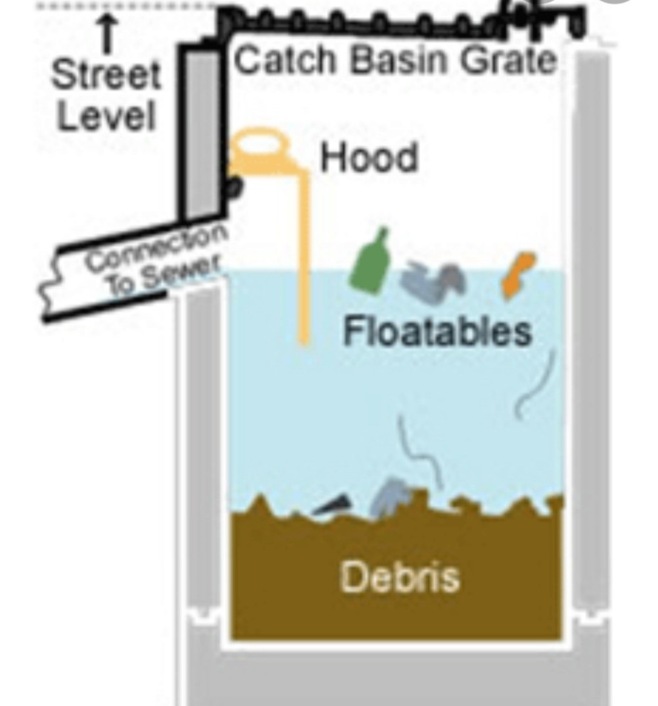
Source Control: Catch Basins Can Capture Floatables

Slide 6
In System Controls: Selection of Underflow Baffles
Initial recommendation of manually cleaned bar screens (1994)
Need to ensure recommendations met performance criteria and intent of the Nine Minimum Controls under Part II.B.6 of EPA’s National CSO Policy.
Evaluated broader alternatives and made site specific recommendations (1996)
Alden Labs builds model of typical regulator structure (1997)
Field Study of underflow baffles (2 locations) and one netting location (1997-2000)
Cambridge Study of additional technologies (1998)
Final Report and Selection of Underflow Baffles as primary control based on efficiency, maintenance requirements and cost-effectiveness

Slide 7
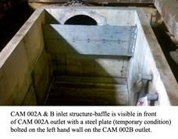
Example of In-system baffle

Slide 8
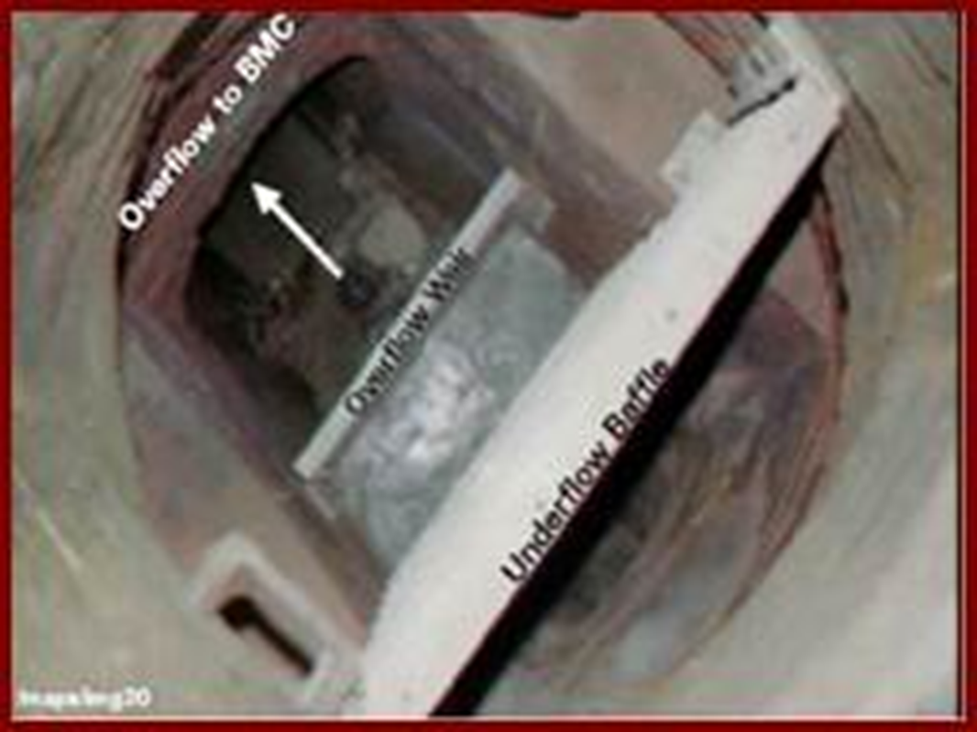
Typical Underflow Baffle Design

Slide 9
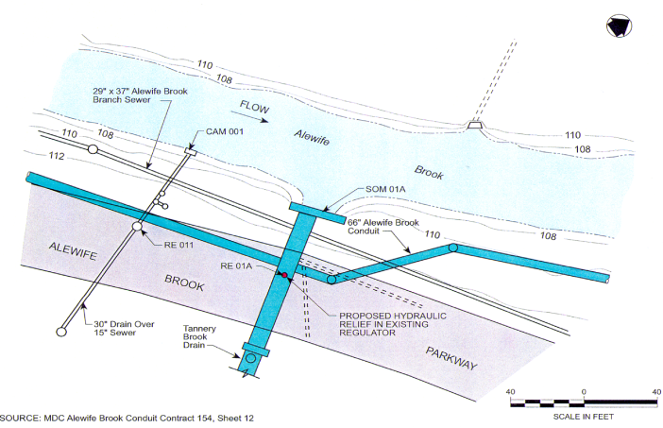

Slide 10
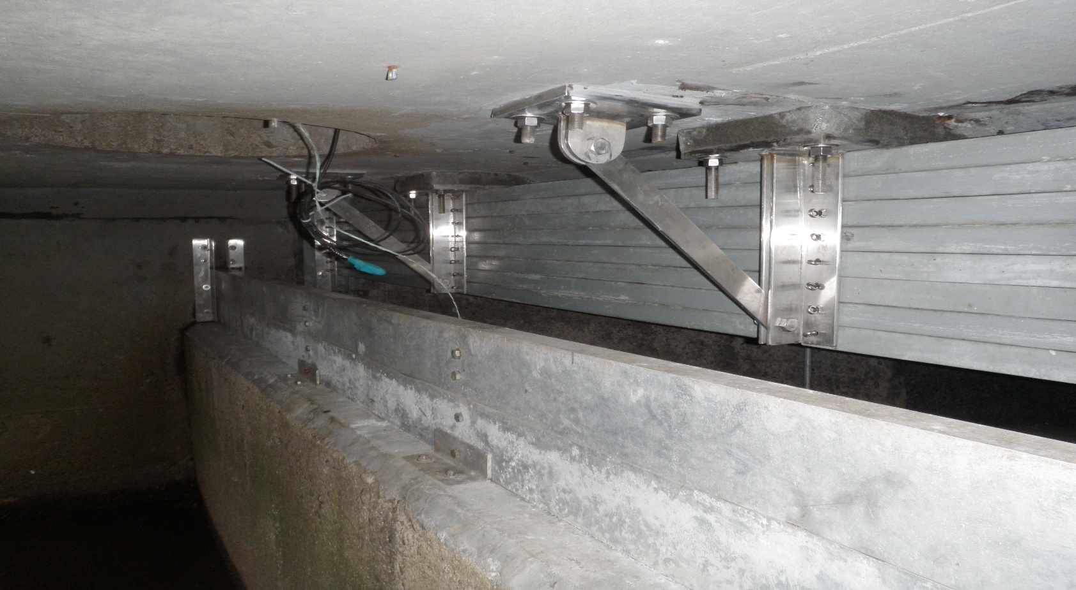
Tannery Brook Underflow Baffle

Slide 11
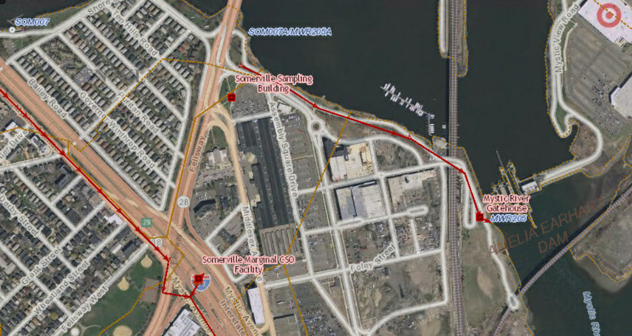
Somerville Marginal Operational Overview
Notes:
CSO Performance Assessment Remaining Work: highlights of continuing activities –
data collection,
CSO quantification from meter data and modeling,
site-specific investigations (including variance projects),
system and operational adjustments to meet LTCP goals,
receiving water model calibration,
water quality assessments,
semiannual reporting.

Slide 12
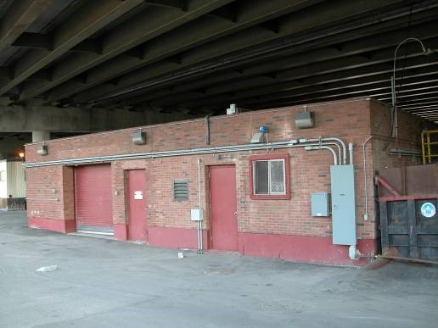
Somerville-Marginal Mechanical Screens on Site

Slide 13
End of Pipe Controls Not Selected
Netting systems rejected from further considerations
More labor intensive
More costly
Disposal of Materials more complicated
Can be unsightly in receiving waters
Containment Booms
Skimmer Boats

Slide 14
Questions??
Lise Marx
Sr. Program Manager, Planning
Lise.Marx@mwra.com
David Kubiak
Sr. Program Manager, Wastewater Engineering
David.Kubiak@mwra.com

