Slide 1
Overview of Hazard Mitigation Planning
June 14, 2018
Melissa A. Surette

Slide 2
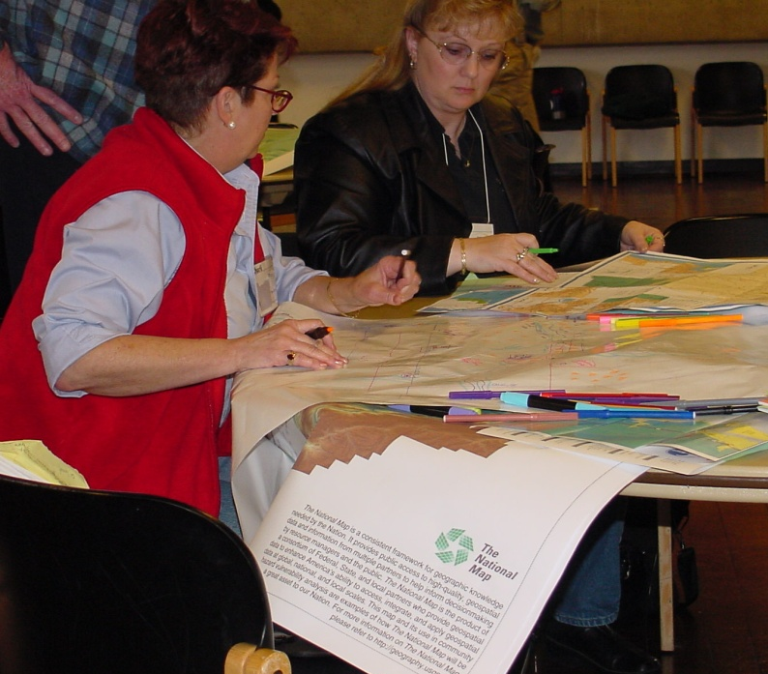
What is Mitigation Planning?
Hazard mitigation is any sustained action taken to reduce or eliminate the long‐term risk to human life and property from hazards
Hazard mitigation activities may be implemented prior to, during, or after an event
Hazard mitigation is most effective when based on an inclusive, comprehensive, long‐term plan that is developed before a disaster occurs
Photo credit: USGS, Wood, 2005

Slide 3
Why Mitigation Planning?
Understand hazards and associated risks
Take steps to make community disaster resilient
FEMA Grant eligibility

Slide 4
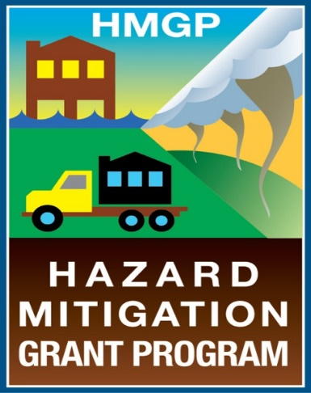
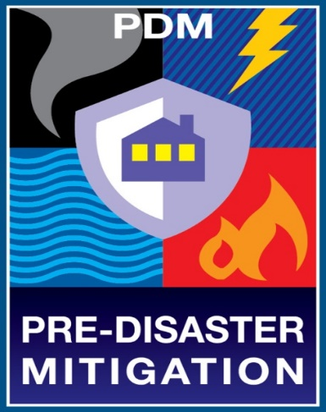
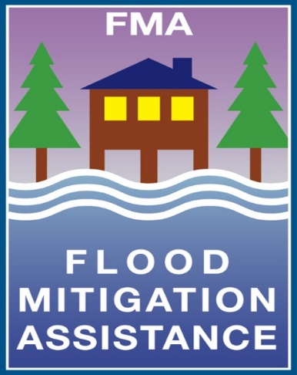
Mitigation Planning Incentives
FEMA provides incentives for mitigation planning in the form of grants
Grant applications are coordinated through state emergency management offices

Slide 5
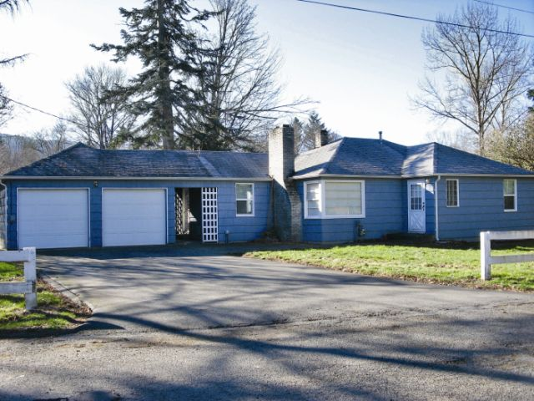
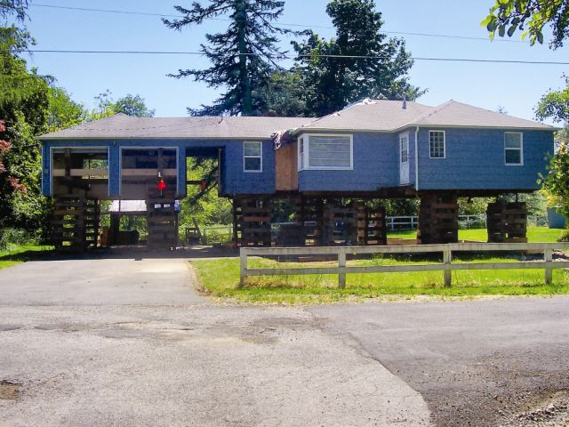
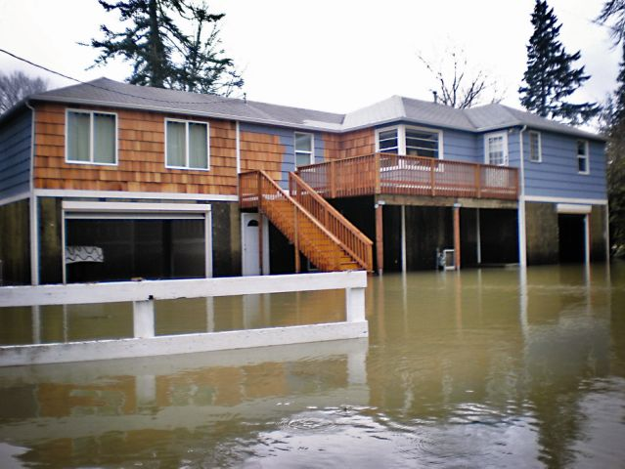
Grant Programs
Pre-Disaster Mitigation Grant cycles typically open each Spring
National competition for States, Locals (apply as sub-applicants to the State), and Tribes
Hazard Mitigation Grant Program (HMGP) is available after a Federally declared Disaster

Slide 6
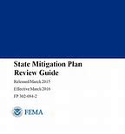
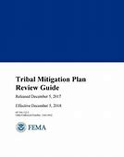
Planning Requirements
State, Tribal, and Local Mitigation Plan Review Guides outline the planning requirements
Requirements differ slightly; however, the overall process is similar
Planning Process
Risk Assessment
Mitigation Strategy
Update (every five years)
Notes:
Hazard Mitigation Plans (HMPs) must be federally approved in order to receive certain grant funding
State Mitigation Plans are one of the first resources a community utilizes when developing a local Mitigation Plan

Slide 7
Considerations as it relates to Nature Based Solutions
Community’s goals
Community’s vulnerabilities
Development in hazard prone areas
Changing future conditions
Notes:
Discuss Development, Future Conditions, etc.
Discuss State/Tribal/local differences
State/Tribal Requirement re: Future Conditions
As part of this requirement, State/Tribe must provide the probability of future hazard events that includes projected changes in occurrences for each natural hazard
Probability must include considerations of changing future conditions, including effects of long-term changes in weather patterns and climate
Changing future conditions is only a State/Tribal requirement; however many local communities are opting to include it in their Risk Assessment and Strategy
Green Infrastructure (GI) is not often considered in a Mitigation Strategy, as GI can provide alternative options for mitigating long-term risk to hazards, especially hazards like drought, where State and local communities may have challenges in identifying solutions to mitigating it, especially with a changing climate
Green infrastructure can be incorporated into the Strategy, providing State and local partners with an opportunity to develop meaningful Hazard Mitigation Plans that meet the current and future needs of their community

Slide 8
Mitigation in Your Community
Does your community have a mitigation plan?
Is it a stand-alone plan or a group of jurisdictions?
Were you or your agency involved in the plan’s development?
Should you or your agency be involved when the plan is updated?
Is your agency responsible for implementing parts of the mitigation plan?
How could you contribute to implementing the plan?

Slide 9
How YOU can Contribute to the Mitigation Plan
Participate in the planning process
Coordinate with other agencies
Provide hazard or risk assessment information
Identify opportunities for the Mitigation Strategy
Implement mitigation activities
Improve your agency’s programs

Slide 10
Mitigation Planning Resources
FEMA Mitigation Planning Website
https://www.fema.gov/hazard-mitigation-planning
FEMA Hazard Mitigation Assistance Website
https://www.fema.gov/hazard-mitigation-assistance
Local Mitigation Plan Review Guide
https://www.fema.gov/media-library/assets/documents/23194
Local Mitigation Planning Handbook
https://www.fema.gov/media-library/assets/documents/31598
Hazard Mitigation: Integrating Best Practices into Planning
http://www.fema.gov/library/viewRecord.do?id=4267
IS-318: Mitigation Planning for Local and Tribal Communities
http://training.fema.gov/EMIWeb/IS/is318.asp
Green Infrastructure Methods
https://www.fema.gov/media-library-data/1487161212568-3b313a4502545a8cf6846f36d53e1367/GI_Fact_Sheet_Feb2017_COMPLIANT.pdf

Slide 11
Town | HMP Status
Arlington | Expired October 17, 2017
Belmont | Expires December 10, 2018
Burlington | Expires August 16, 2021
Cambridge | Expires May 23, 2021
Chelsea | Expires March 2, 2022
Everett | Expires October 20, 2021
Lexington | Expired June 9, 2016
Malden | Expires May 24, 2022
Medford | Expires June 13, 2022
Melrose | Expired April 14, 2010
Reading | Expires August 9, 2022
Revere | Expires August 11, 2020
Stoneham | Expired August 26, 2016
Wakefield | Expired March 26, 2013
Winchester | Expires May 12, 2021
Winthrop | Expires August 2, 2020
Woburn | Expires July 10, 2021

